Slide 1
Markov Decision processes
Scott O’Hara
Metrowest Developers Machine Learning Group
08/29/2018

Slide 2
References
The material for this talk is drawn from the slides, notes and lectures from several offerings of the CS181 course at Harvard University:
CS181 Intelligent Machines: Perception, Learning and Uncertainty, Sarah Finney, Spring 2009
CS181 Intelligent Machines: Perception, Learning and Uncertainty, Prof. David C Brooks, Spring 2011
CS181 – Machine Learning, Prof. Ryan P. Adams, Spring 2014. https://github.com/wihl/cs181-spring2014
CS181 – Machine Learning, Prof. David Parkes, Spring 2017. https://harvard-ml-courses.github.io/cs181-web-2017/

Slide 3
Overview
Introduction
Types of Machine Learning
Decision Theory
Markov Decision Processes
Definitions
Examples
MDP Solutions
finite horizon techniques
expectimax
value iteration
Infinite horizon techniques
value iteration
policy iteration

Slide 4

Types of Machine Learning
There are (at least) 3 broad categories of machine learning problems:
Supervised Learning
$Data=\left\{\left(x_{1},y_{1}\right),…,\left(x_{n},y_{n}\right)\right\}$
e.g., linear regression, decision trees, SVMs
Unsupervised Learning
$Data=\left\{x_{1},,…,x_{n}\right\}$
e.g., K-means, HAC, Gaussian mixture models
Reinforcement Learning
$Data=\left\{s_{1},a_{1},r_{1},s_{2},a_{2},r_{2}… \right\}$
an agent learns to act in an uncertain environment by training on data that are sequences of state, action, reward.

Slide 5
Decision Theory
The three components of the decision theoretic framework MDPs:
Probability
Use probability to model uncertainty about the domain.
Utility
Use utility to model an agent’s objectives.
Decision Policy
The goal is to design a decision policy, describing how the agent should act in all possible states in order to maximize its expected utility.

Slide 6
Uncertainty modeled with Probability
The agent may not know the current state of the world
The effects of the agent’s action might be unpredictable.
Things happen that are outside the agent’s control.
The agent may be uncertain about the correct model of the world.

Slide 7
“Happiness” modeled with utility
Utility is a real number.
The higher the utility, the “happier” your robot is.
Utility is based on the assumptions of Utility Theory, which if obeyed, make you rational.
For example, if you prefer reward A to reward B, and you prefer reward B to reward C, then you should prefer reward A to reward C.

Slide 8
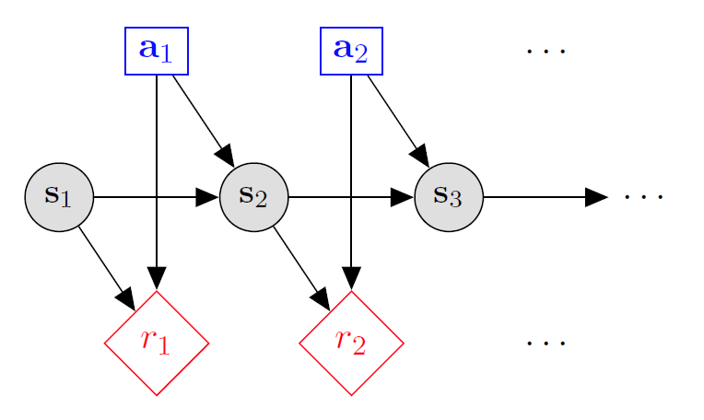

Markov decision processes
States: $s_{1},…,s_{n}$
Actions: $a_{1},…,a_{m}$
Reward Function: $r\left(s,a\right)∈R$
Transition model: $p\left(s′ | s, a\right)$

Slide 9
Markov decision processes
GOAL: find a policy π that tells you what action to take in each state. We want to find ‘rewarding’ policies.

Slide 10
Application 1: Robots
States: physical location, objects in environment
Actions: move, pick-up, drop, …
Reward Function: +1 if pick up dirty clothes, -1 if break dish
Transition model: describe actuators and uncertain environment.

Slide 11
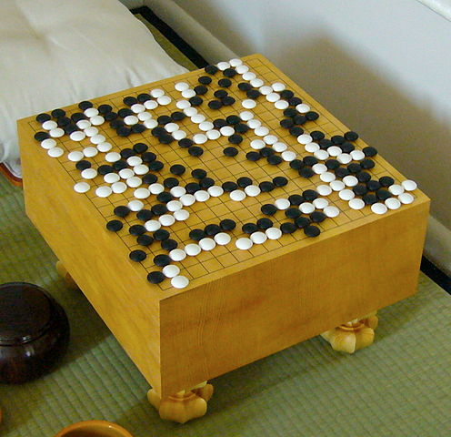
Application 2: game of go
States: board position
Actions: place a piece
Reward Function: +1 if win the game, 0 if draw, -1 if lose.
Transition model: rules of the game, response of other player.

Slide 12
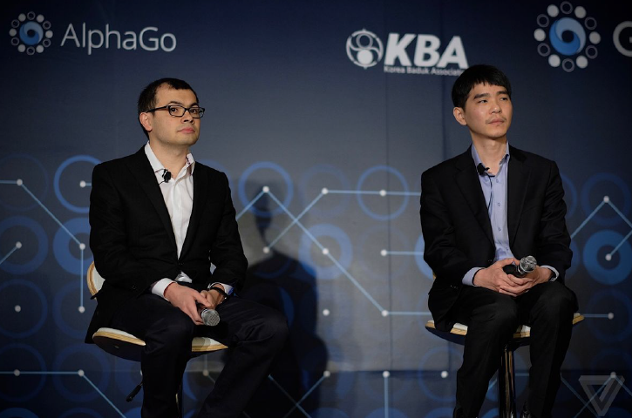
AlphaGo vs. Lee Sedol
AlphaGo (DeepMind) defeated Lee Sedol, 4-1 in March 2016, the top Go player in the world
AlphaGo combines Monte-Carlo tree search with deep neural nets (trained by supervised learning), with reinforcement learning.
Learns both a `policy network' (which action to play in which state) and a `value network' (estimate of value of an action under self-play).

Slide 13
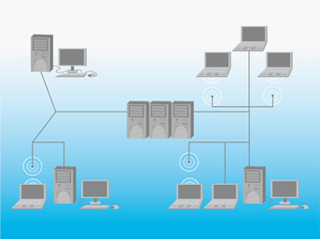
Application 3: email routing
States:
up/down for each server
current location and goal of each message.
Actions: choose path of servers for each message.
Reward Function: +1 for each message delivered to goal.
Transition model: describe network of servers.

Slide 14
Application 3: transition model
P(s’|s, a) depends on:
probability that each server fails given current load
probability that new messages enter the queue
probability that each message completes hop, given the state of the servers

Slide 15
Scope of MDP applicability
The Markov Decision Process is a general probabilistic framework, and can be applied in many different scenarios.
Planning ← this talk
Full access to the MDP, compute an optimal policy.
“How do I act in a known world?"
Policy Evaluation ← this talk
Full access to the MDP, compute the `value' of a fixed policy.
“How will this plan perform under uncertainty?“
Reinforcement Learning (later)
Limited access to the MDP.
“Can I learn to act in an uncertain world?"

Slide 16

Different Objective criteria
Sequence of $s_{1}, a_{1},r_{1},s_{2},a_{2},r_{2}…$; discrete time t
Finite horizon, $T≥1$ steps
$$utility=\sum_{t=1}^{T}{r\left(s_{t},a_{t}\right)}$$
Infinite horizon, discount factor $γ ε \left(0\right.,\left.1\right]$
$$utility=r\left(s_{1},a_{1}\right)+γ∙r\left(s_{2t},a_{2}\right)+γ^{2}∙r\left(s_{3},a_{3}\right)+…$$
$$utility=\sum_{t=1}^{T}{γ^{t−1}∙r\left(s_{t},a_{t}\right)}$$

Slide 17
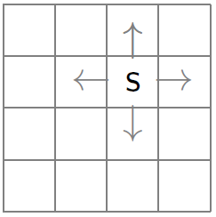
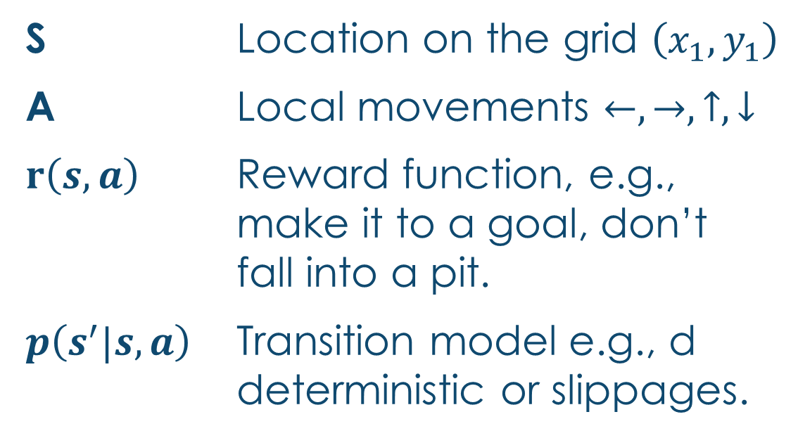
Optimal policy examples: gridworld
S Location on the grid $\left(x_{1},y_{1}\right)$
A Local movements $←,→,↑,↓$
$r\left(s,a\right)$ Reward function, e.g., make it to a goal, don’t fall into a pit.
$p\left(s^{′}|s,a\right)$ Transition model e.g., d deterministic or slippages.

Slide 18
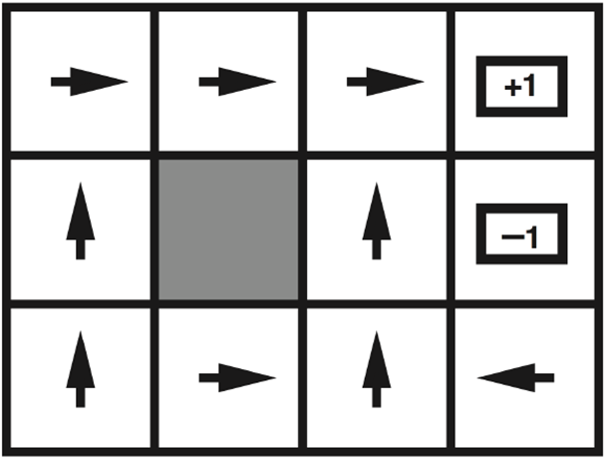
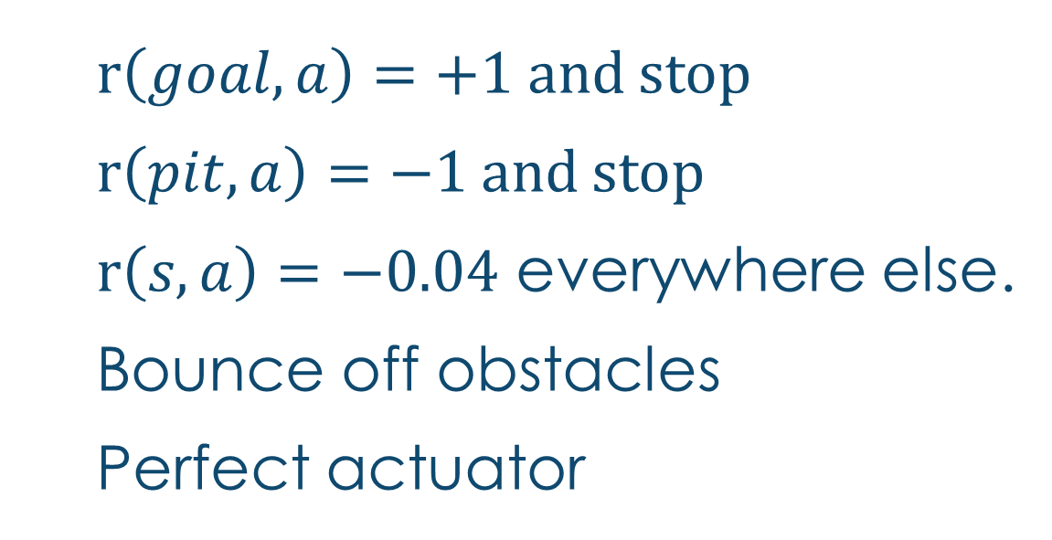
Optimal policy: perfect actuator
Goal
$r\left(goal,a\right)=+1$ and stop
$r\left(pit,a\right)=−1$ and stop
$r\left(s,a\right)=−0.04$ everywhere else.
Bounce off obstacles
Perfect actuator
Pit

Slide 19
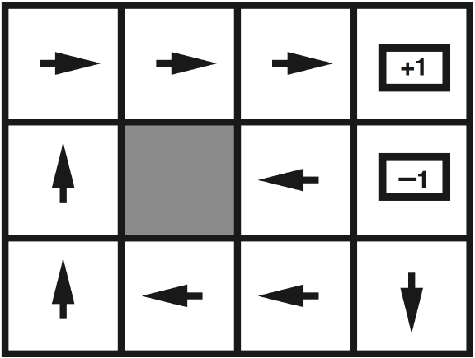

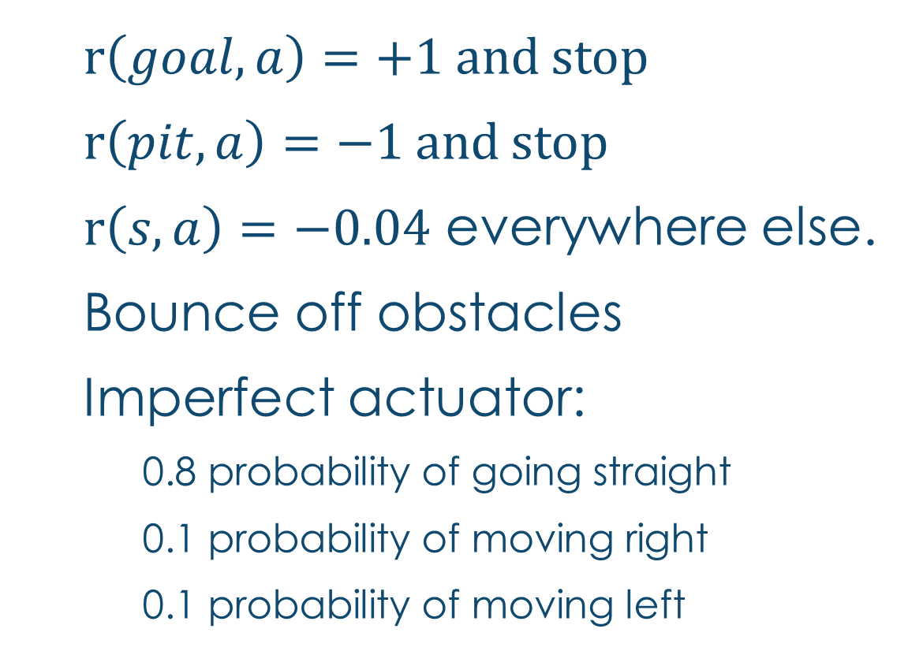



Optimal policy: Imperfect actuator
$r\left(goal,a\right)=+1$ and stop
$r\left(pit,a\right)=−1$ and stop
$r\left(s,a\right)=−0.04$ everywhere else.
Bounce off obstacles
Imperfect actuator:
0.8 probability of going straight
0.1 probability of moving right
0.1 probability of moving left
Goal
Pit

Slide 20
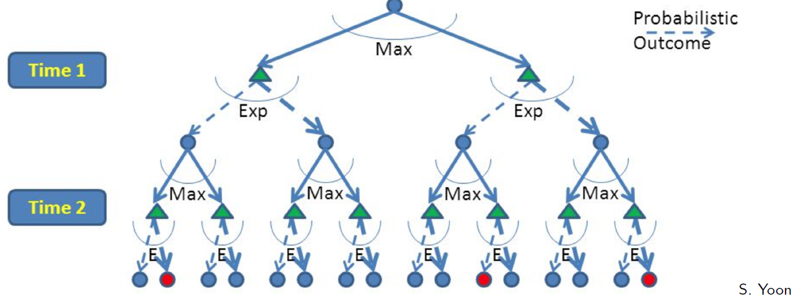
Finite horizon : Expectimax
Build out a look-ahead tree to the decision horizon; max over actions, exp over next states.
Solve from the leaves, backing-up the expectimax values.
Problem: computation is exponential in horizon.
May expand the same subtree multiple times.

Slide 21
Expectimax: A game against Nature
Like a game except opponent is probabilistic
Strongly related minmax used in game theory
Nodes where you move: S ( )
Nodes where nature moves: <S,A> ( )

Slide 22
Policy and values
Policy: action to take at each state
Value of state (node): expected total reward
Depends on policy

Slide 23
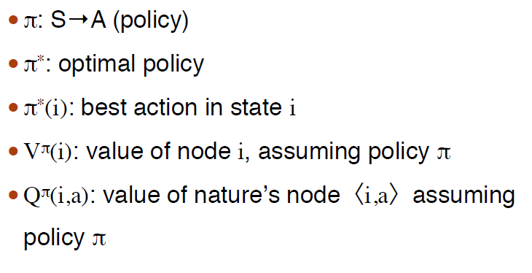
notation

Slide 24
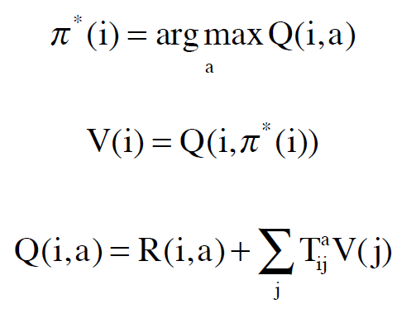
Basic equations

Slide 25
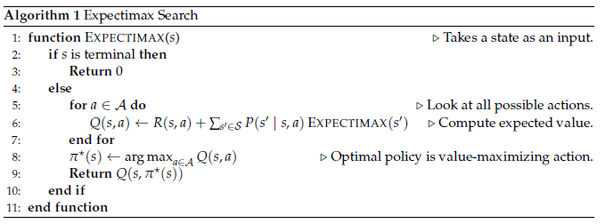
Expectimax algorithm

Slide 26
2-state Finite horizon Example
<A1, 1.0, -1>
<A2, 1.0, +0>
<A1, 0.6, +1>
S1
S2
<A1, 0.4, +1>
<A2, 1.0, +0>
States: S1, S2
Actions: A1,A2
Edges: <action, probability, value>

Slide 27
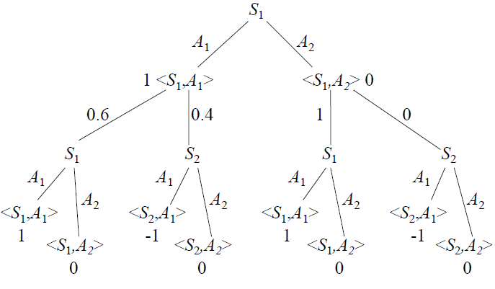
Expectimax: Game tree example (1)

Slide 28
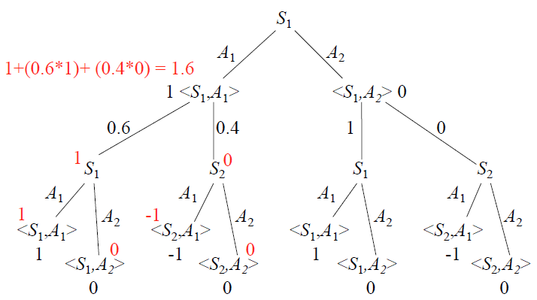
Expectimax: Game tree example (2)

Slide 29
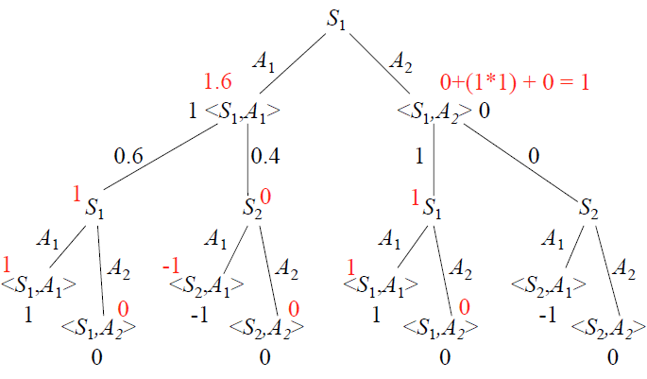
Expectimax: Game tree example (3)

Slide 30
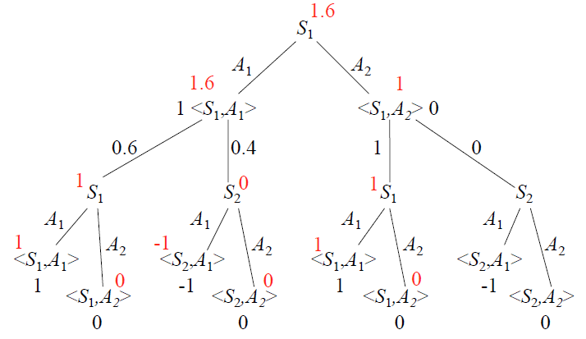
Expectimax: Game tree example (4)

Slide 31

Complexity of expectimax
Linear in size of tree
Exponential in horizon
Base of the exponent: (# of actions) * (# of transitions)
O$\left({\left(m∙l\right)}^{h}\right)$
h = horizon
m = number of actions
l = maximum # of non-zero transitions from state

Slide 32
Avoid Exponential blowup with dynamic programming
The same state can be reached by many paths
To solve a large problem, solve smaller subproblems
Must be able to combine subproblem solutions effectively to solve larger problems.
For Expectimax, the solution is Value iteration

Slide 33
Value iteration
Break up problem by number of steps to go
Given optimal policy for k-1 steps to go, compute Q-values for k steps to go
Base case value with no timesteps to go

Slide 34
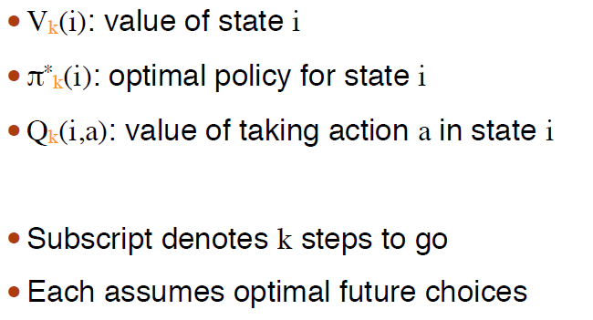
k-steps-to-go notation

Slide 35
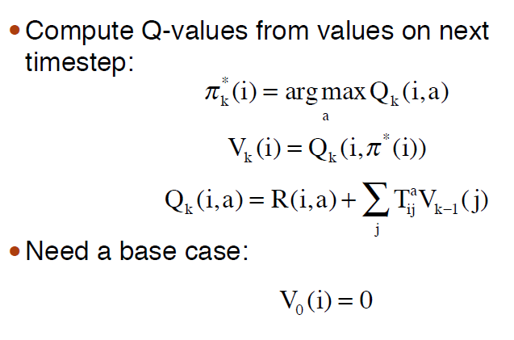
Basic equations

Slide 36
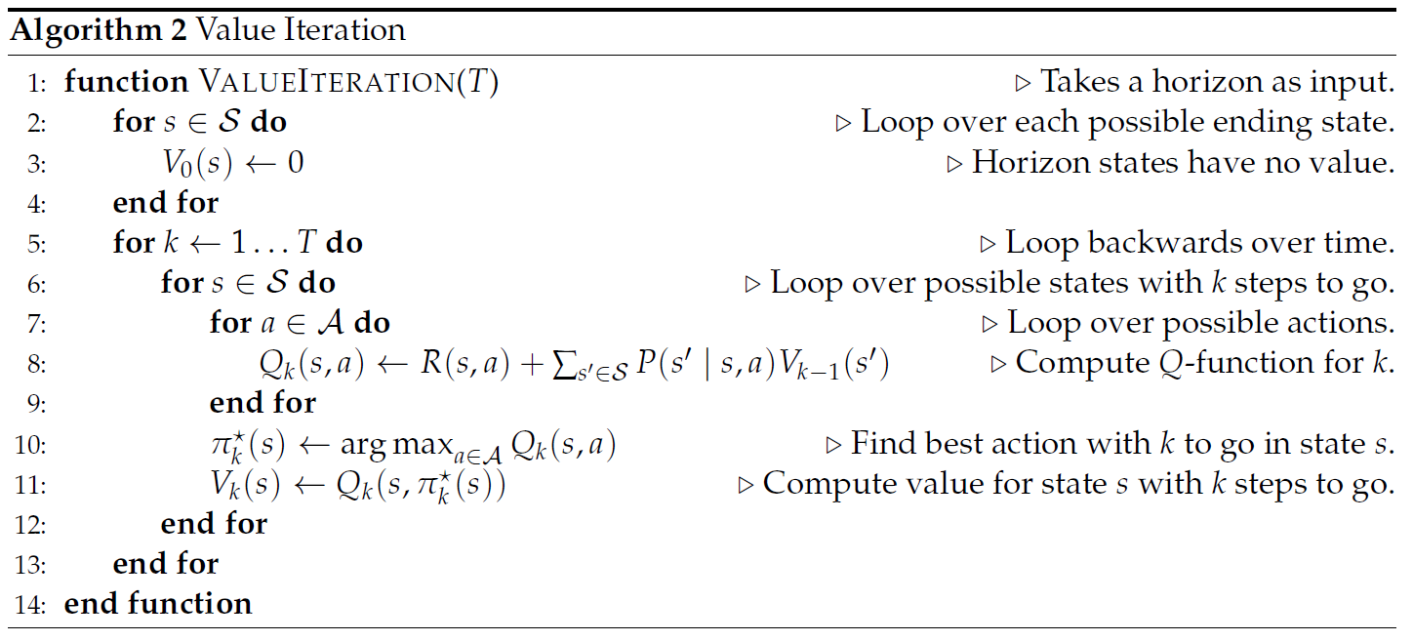
Value iteration algorithm

Slide 37
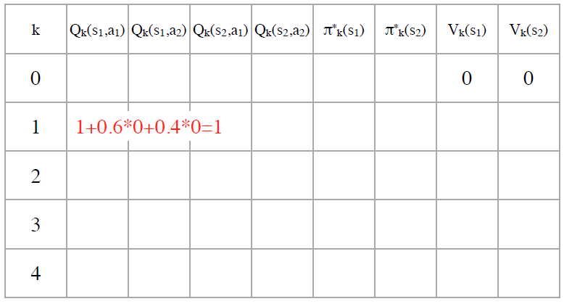
Value iteration example (1)

Slide 38
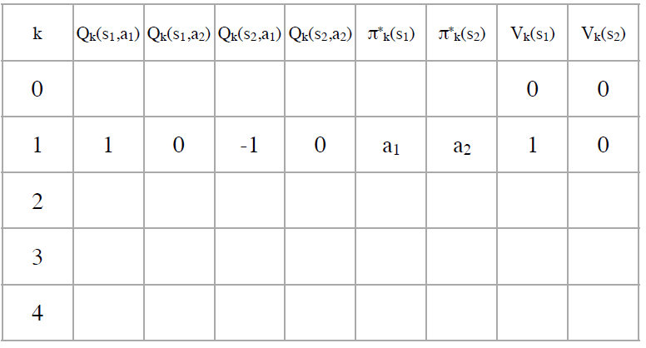
Value iteration example (2)

Slide 39
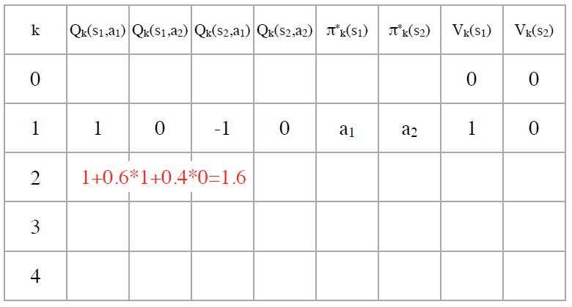
Value iteration example (3)

Slide 40
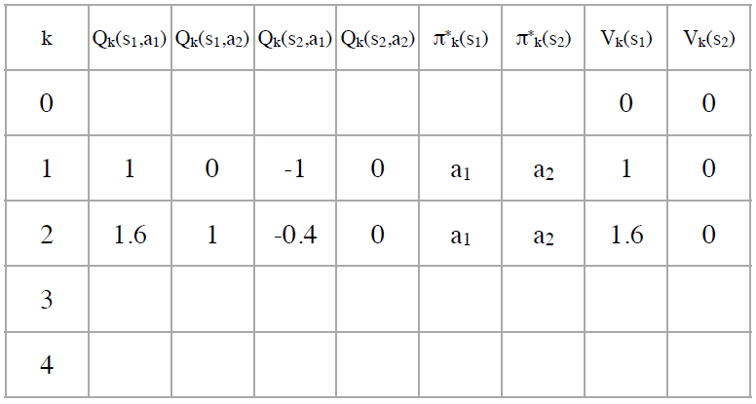
Value iteration example (4)

Slide 41
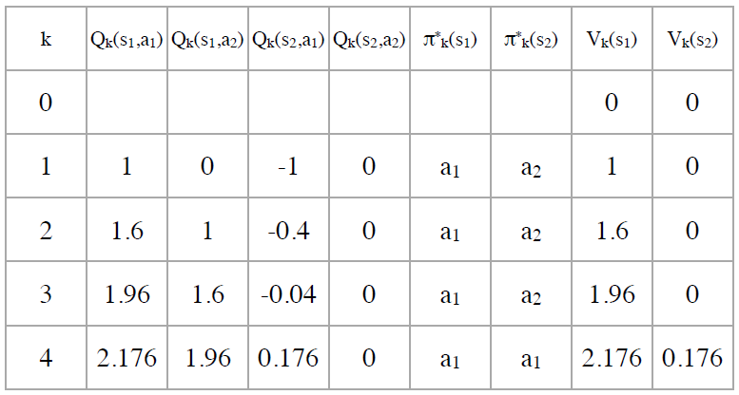
Value iteration example (5)

Slide 42
Horizon effect
h = 1: greedy; only consider immediate reward
h is small: only consider short term rewards, no long-term planning
h is large: willing to sacrifice short-term gain for long-term reward

Slide 43
complexity of value iteration
h = horizon, m actions, n states
l = max number of non-zero outgoing transitions
# of Q-values per time step: m*n
How long to compute Q-value? Need to sum over possible next states: O(l)
Total cost: O(mnlh)

Slide 44
Comparison
Value iteration is better when states can be reached by multiple paths
Expectimax is better when each state is reachable only one way and many states cannot be reached at all

Slide 45
Infinite horizon
Expectimax and finite horizon value iteration rely on a finite horizon since both algorithms assume a base case.
We would like to look infinitely far into the future.
To do this, we consider discounting future
we may never get there
the equations don’t blow up

Slide 46
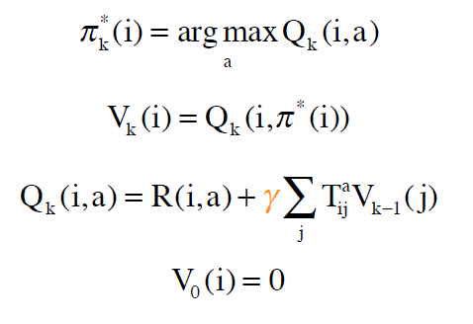
Basic equations for infinite horizon value iteration

Slide 47
Value iteration (finite Horizon)

Slide 48
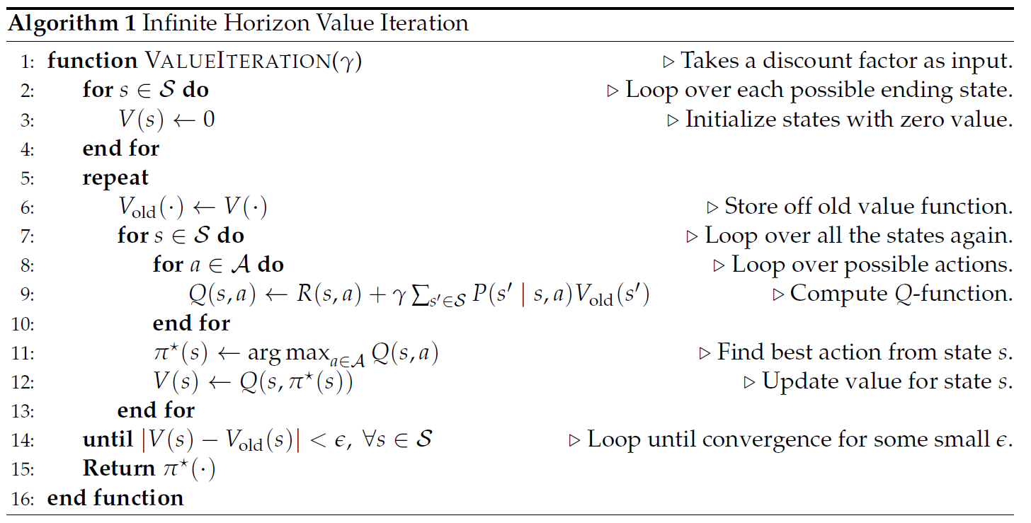
Value iteration (Infinite Horizon)

Slide 49
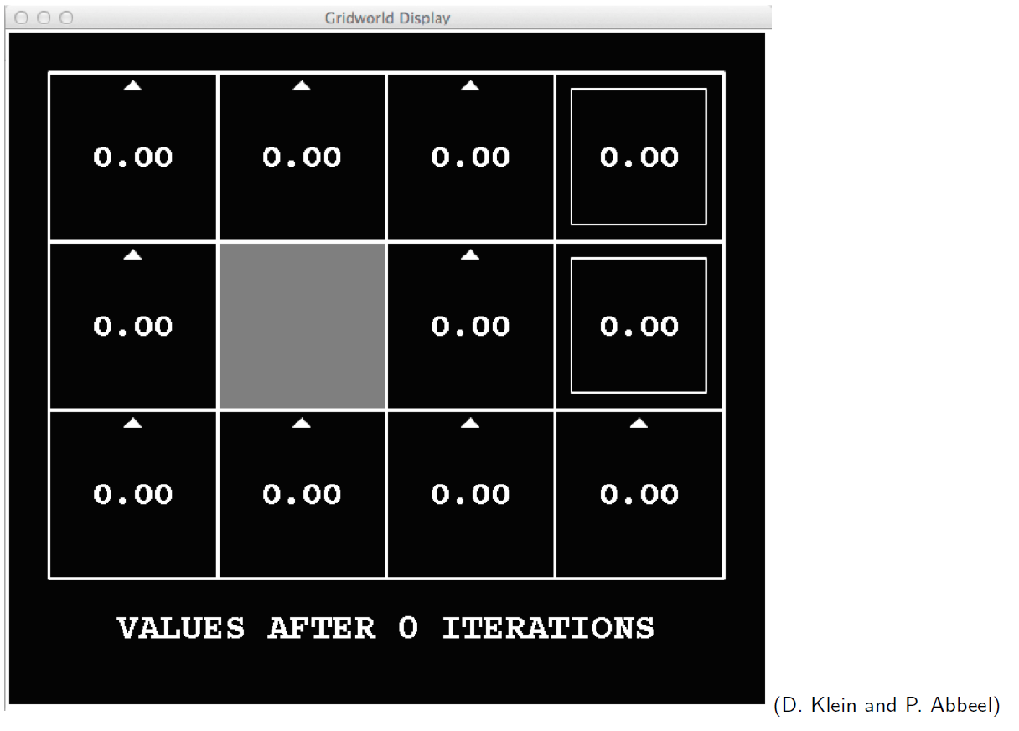
Value iteration in gridworld (0)

Slide 50
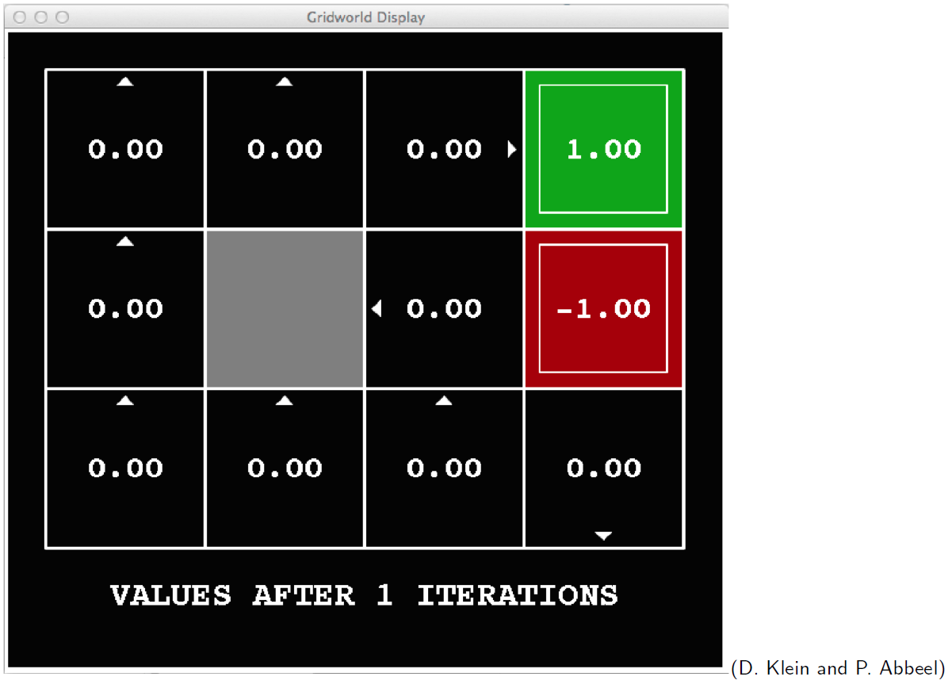
Value iteration in gridworld (1)

Slide 51
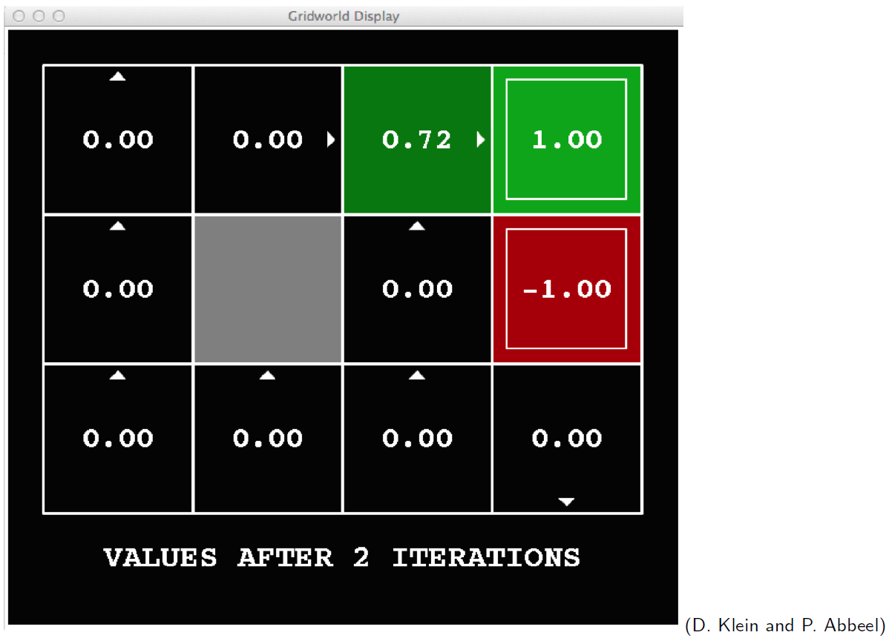
Value iteration in gridworld (2)

Slide 52
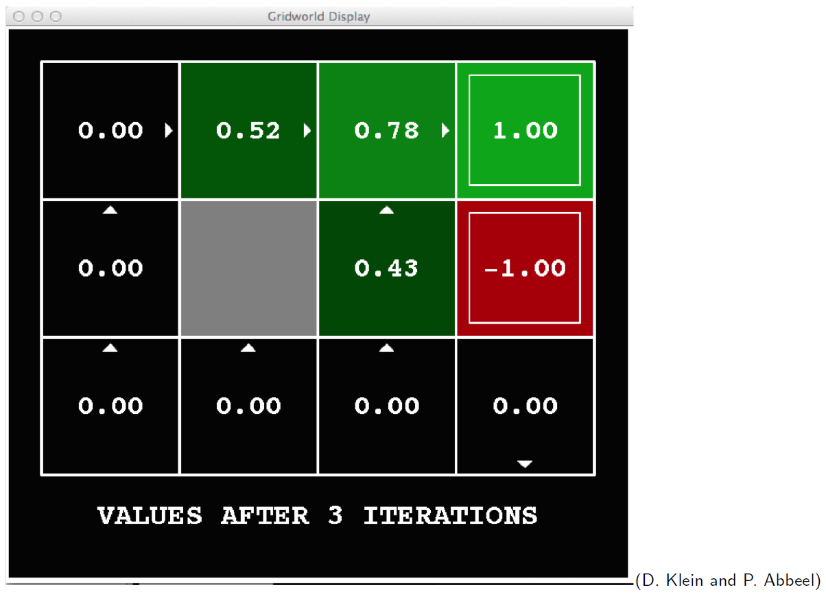
Value iteration in gridworld (3)

Slide 53
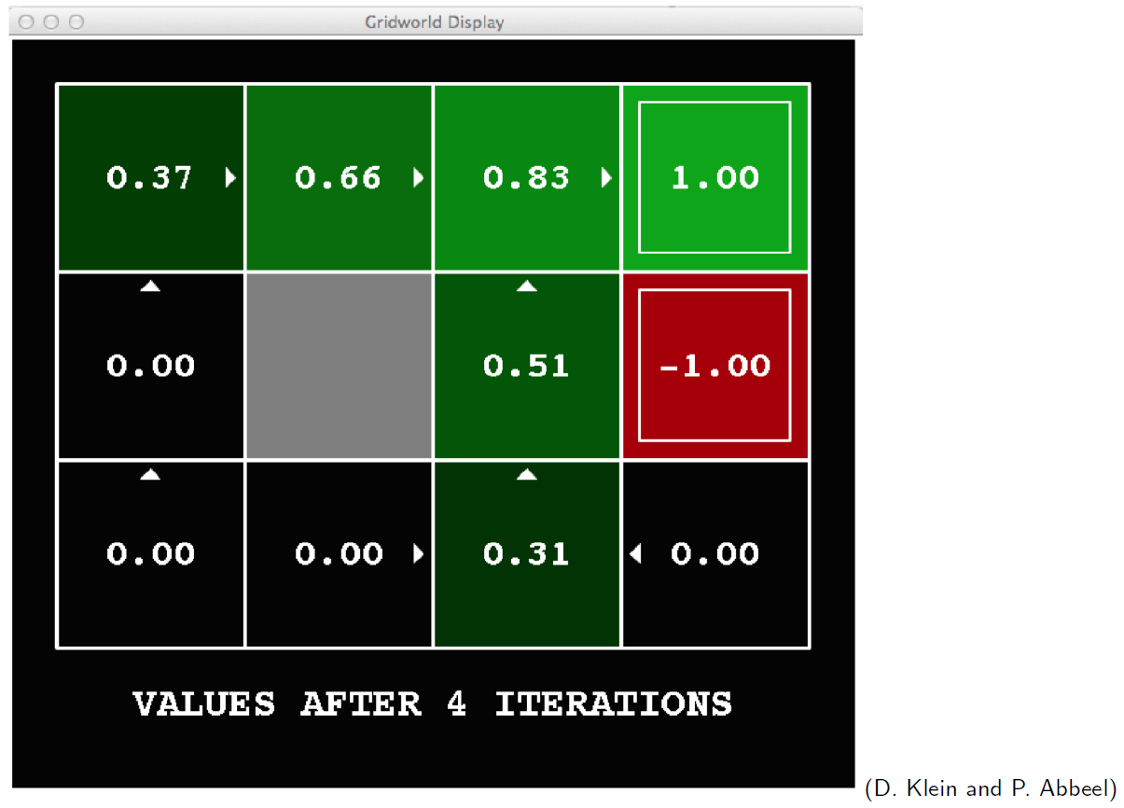
Value iteration in gridworld (4)

Slide 54
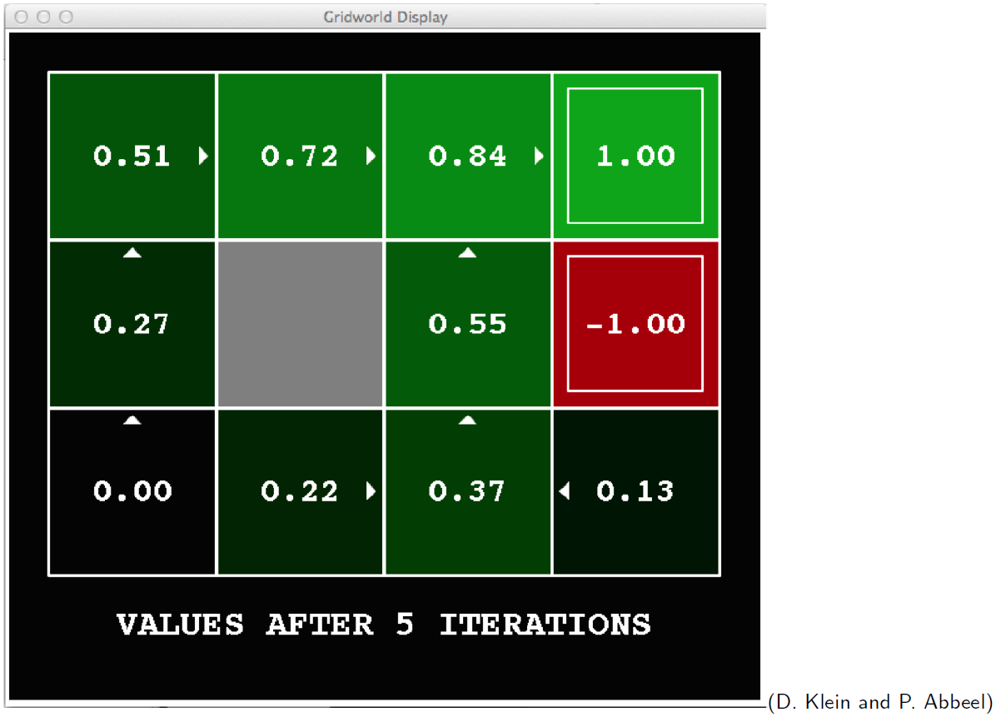
Value iteration in gridworld (5)

Slide 55
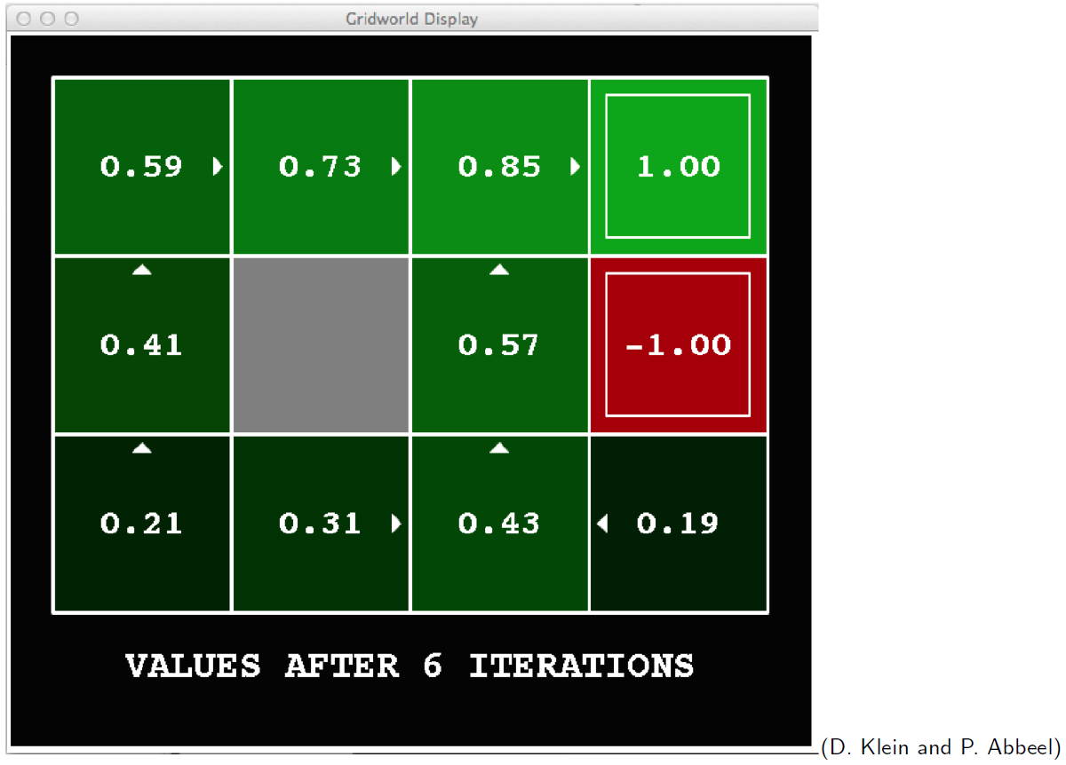
Value iteration in gridworld (6)

Slide 56
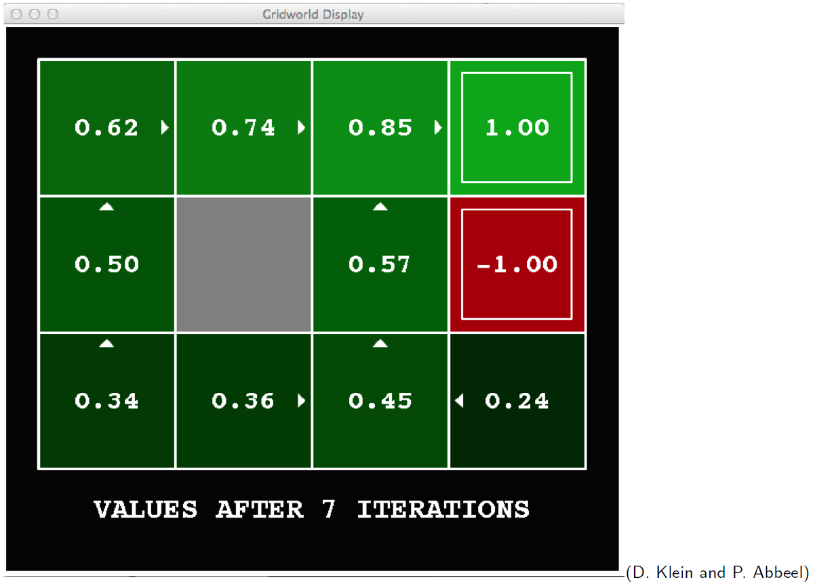
Value iteration in gridworld (7)

Slide 57
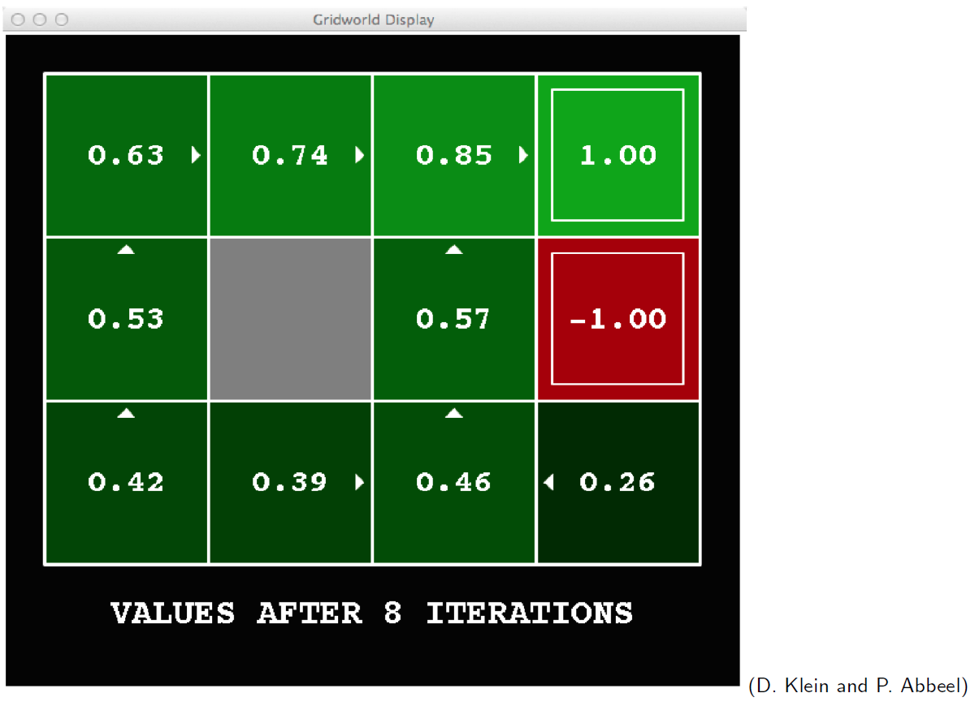
Value iteration in gridworld (8)

Slide 58
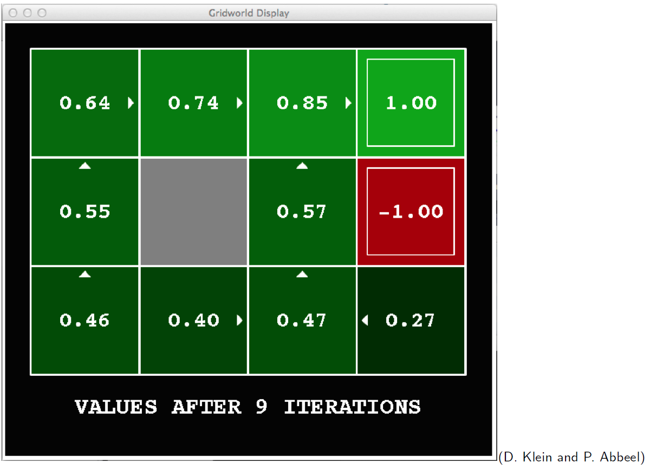
Value iteration in gridworld (9)

Slide 59
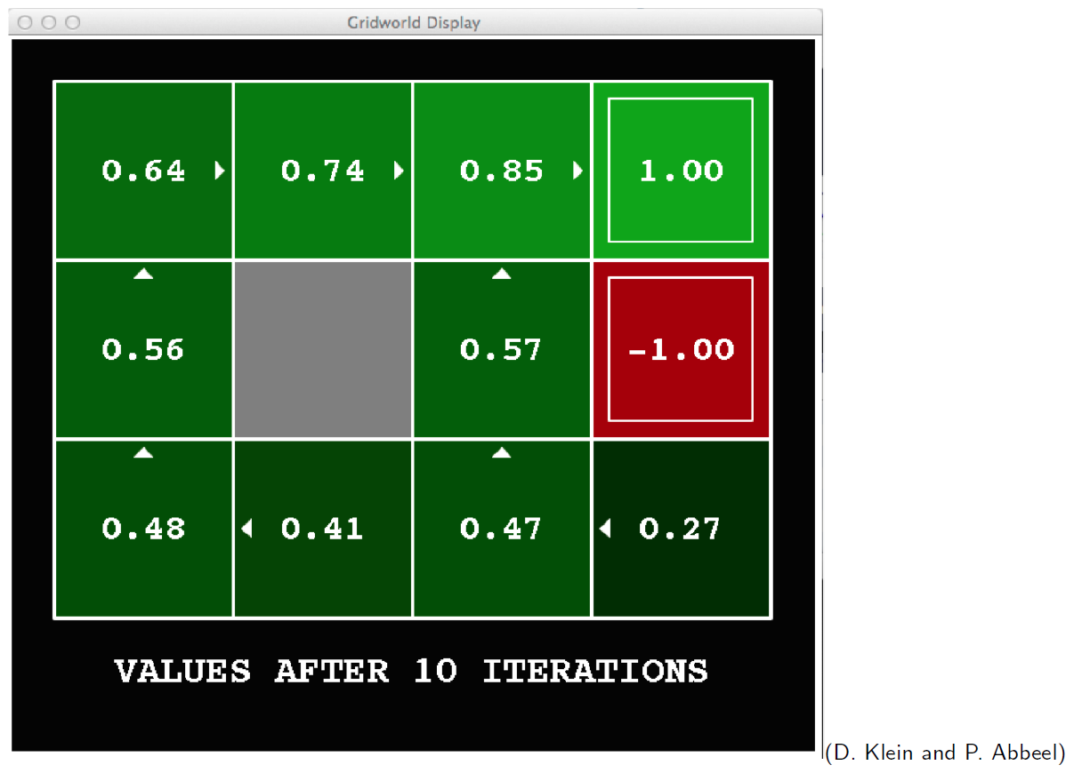
Value iteration in gridworld (10)

Slide 60
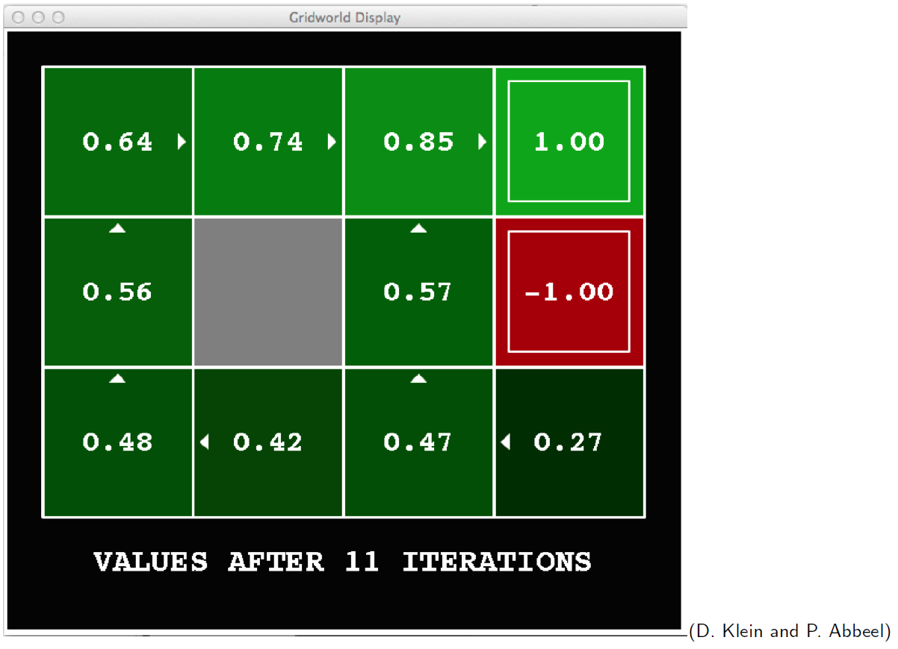
Value iteration in gridworld (11)

Slide 61
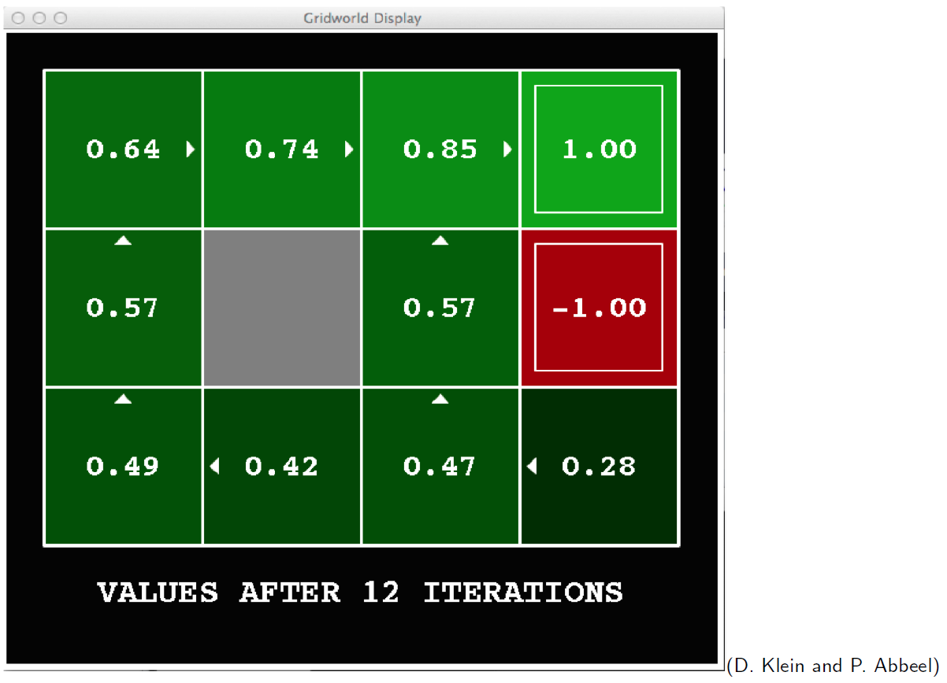
Value iteration in gridworld (12)

Slide 62
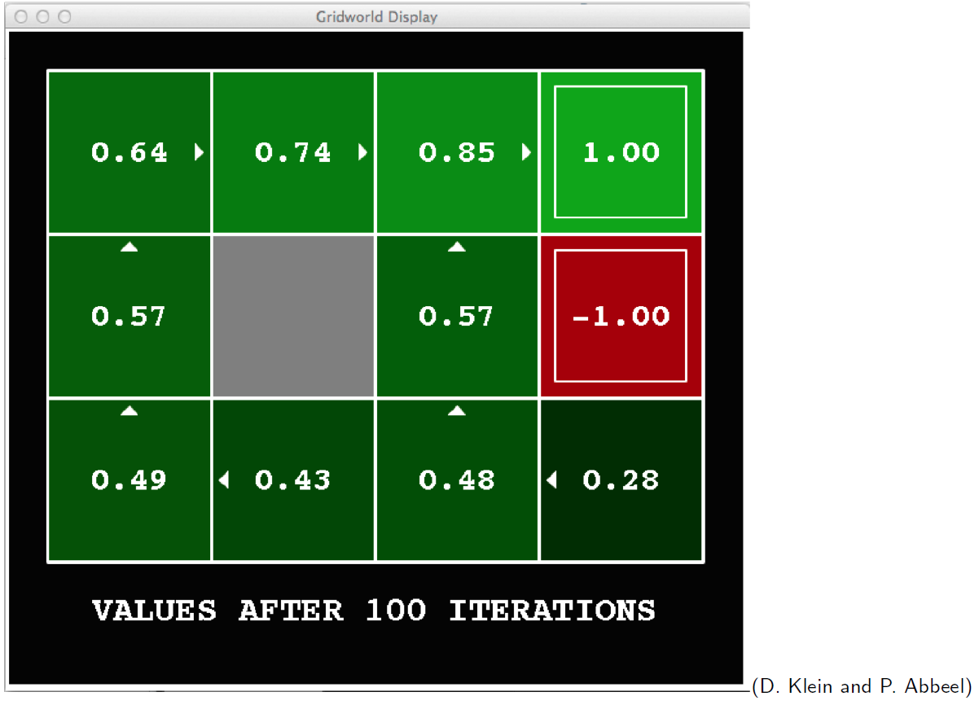
Value iteration in gridworld (100)

Slide 63
Problems with value iteration
The ‘max’ value at each state rarely changes.
The policy often converges long before the values converge.
Policy iteration is an alternative approach, which is still optimal and can converge much more quickly.

Slide 64
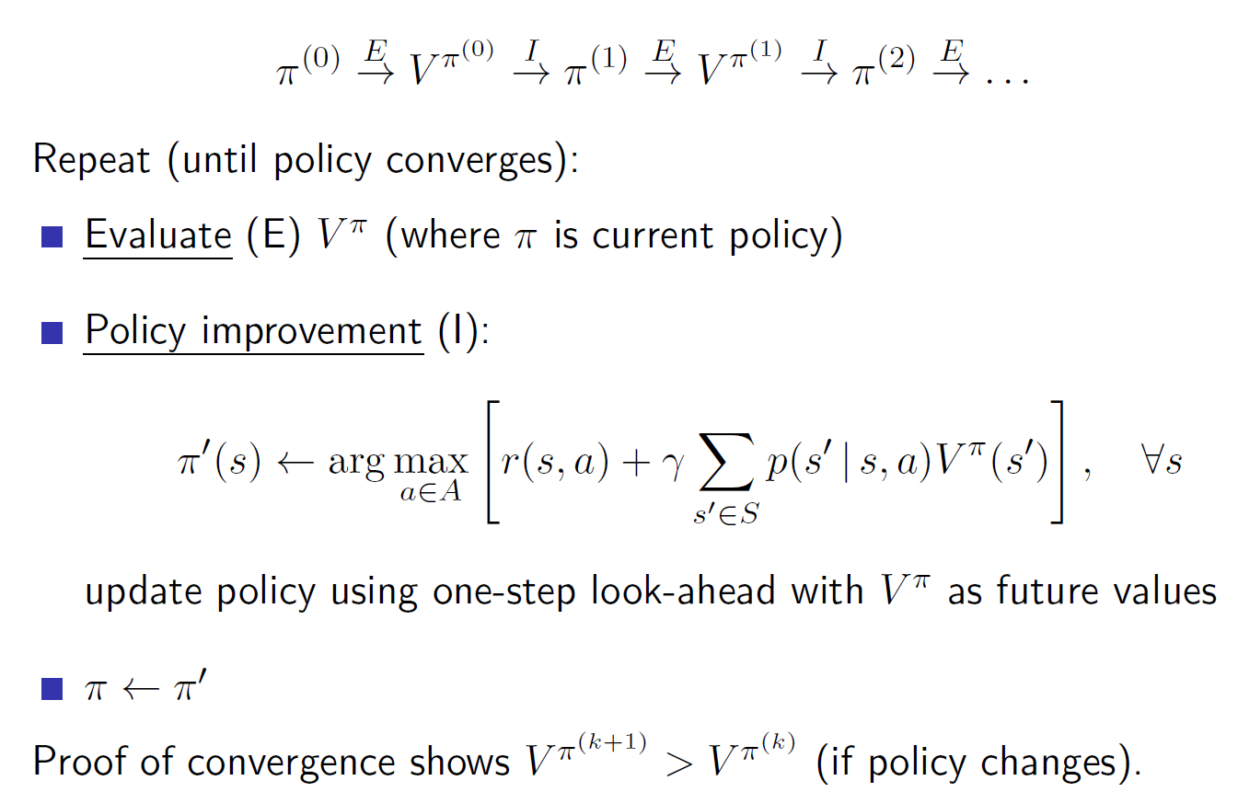
policy iteration

Slide 65
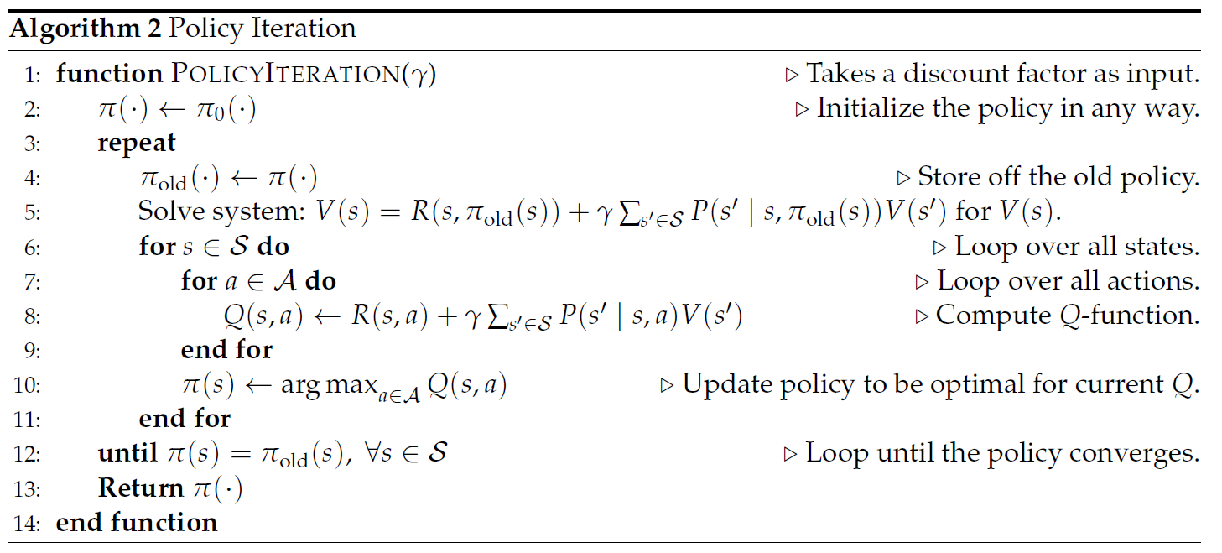


policy iteration

Slide 66
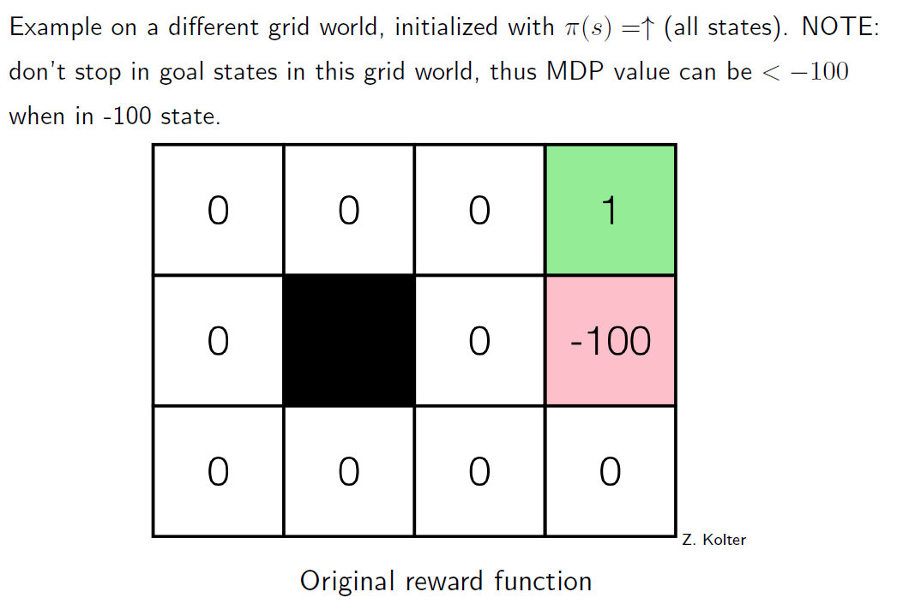
policy iteration Example (0)

Slide 67
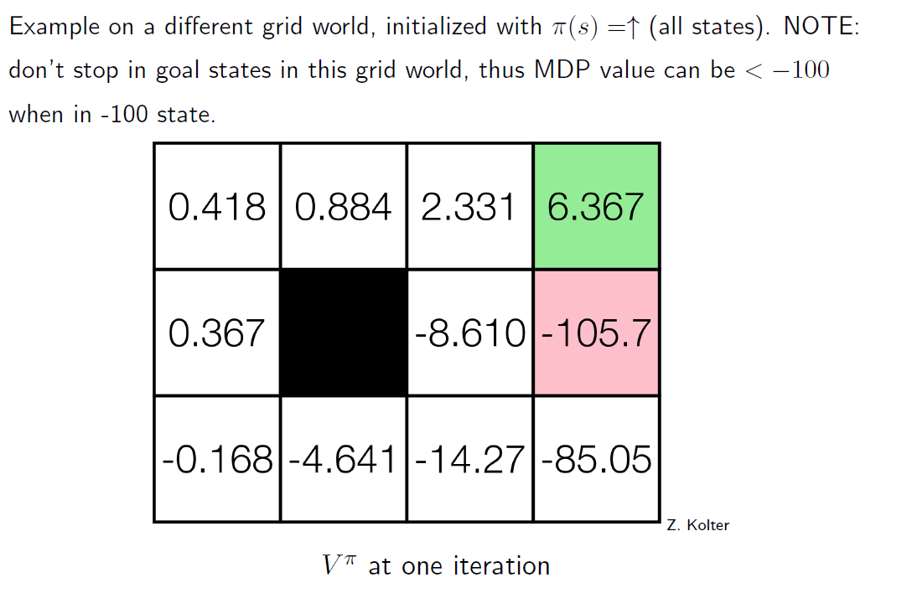
policy iteration Example (1)

Slide 68
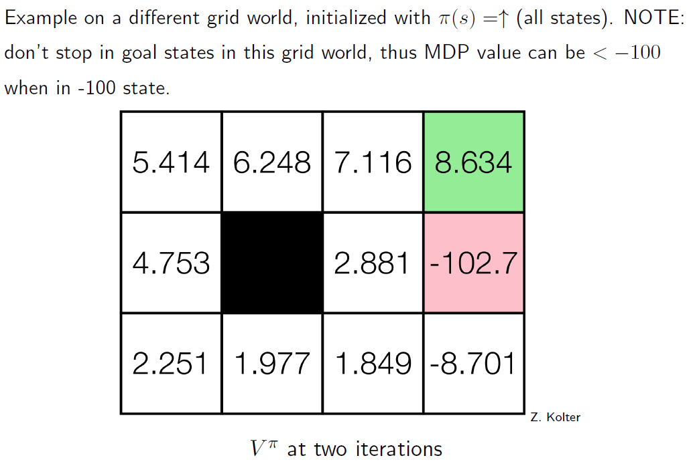
policy iteration Example (2)

Slide 69
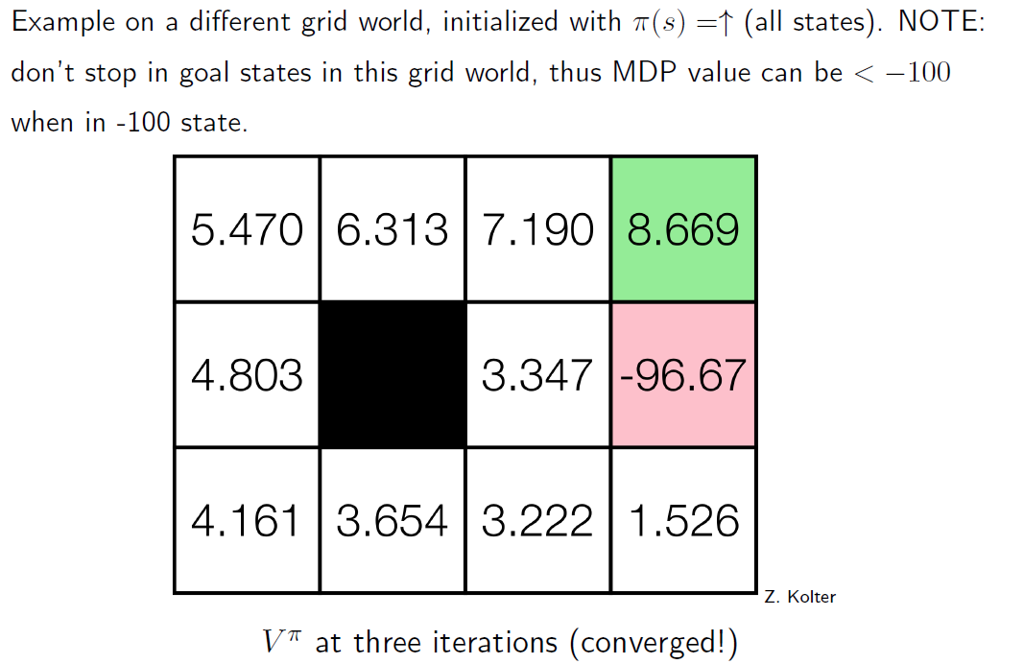
policy iteration Example (3)

